Slide 1

School Project: HeBLE
Healthy body lifestyle entertainment

Slide 2

what is our project?
We wanted to create something that motivate others to workout. By giving users different movement taks. Users can earn experience points for completing these tasks and can level up, just like in a video game, keeping it fun.
We also have various free content available for users.

Slide 3
Application Features
User registration and login
Tracking user workouts
Suggestions for a healthier lifestyle (diet, workout tips, etc.)
Earning points based on your workouts
This way you can make progress, which allows you to get various rewards and achieve achievements.

Slide 4
Members of our team
János Bence Dakos, Frontend developing
Gergő Fodor,
Frontend developing
Patrik András Sedlák, Backend developing

Slide 5



Technologies Used
Used for coding:
Frontend: Angular 19
Backend: NodeJS
Packages: argon2, bcrypt, bcryptjs, cors, dotenv, express, express-validator, mysql2, nodemon, sequelize and more...
Database: MySQL (MariaDB) [XAMPP]

Slide 6




Technologies Used
Other development tools:
Teamwork software: Trello, GitHub
Image design and editint software: Adobe Photoshop, Canva

Slide 7
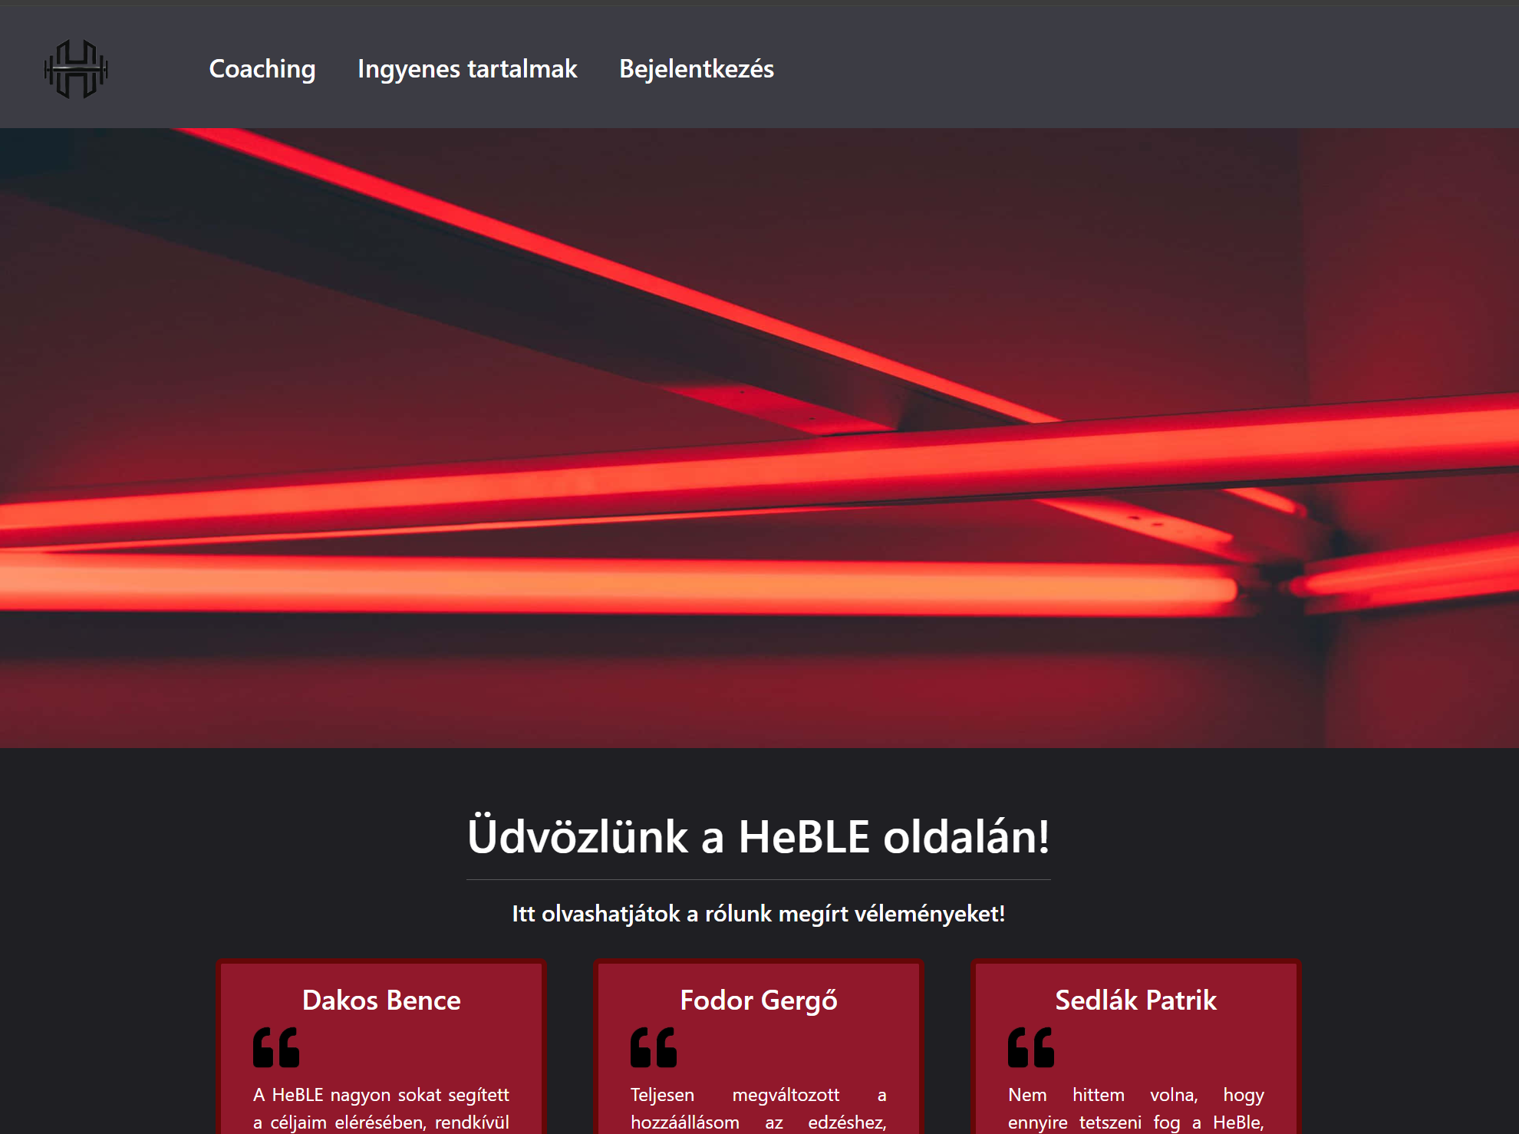
gERGŐ’s WORK
Frontend:
The development environment was Visual Studio Code, we used it throughout our school studies, so it was what we knew best.
The framework was Angular. (version 19)

Slide 8

Gergő’s work in details
We wanted our website to be fully responsive, so we focused on achieving this using CSS elements and Bootstrap. I used different Bootstrap pre-made components.
The static appearance of the web application and its content. This includes the navbar and footer along with their elements (contact and about us), the landing page, the free content.
Some dynamic functions, like signup and login, authentication

Slide 9
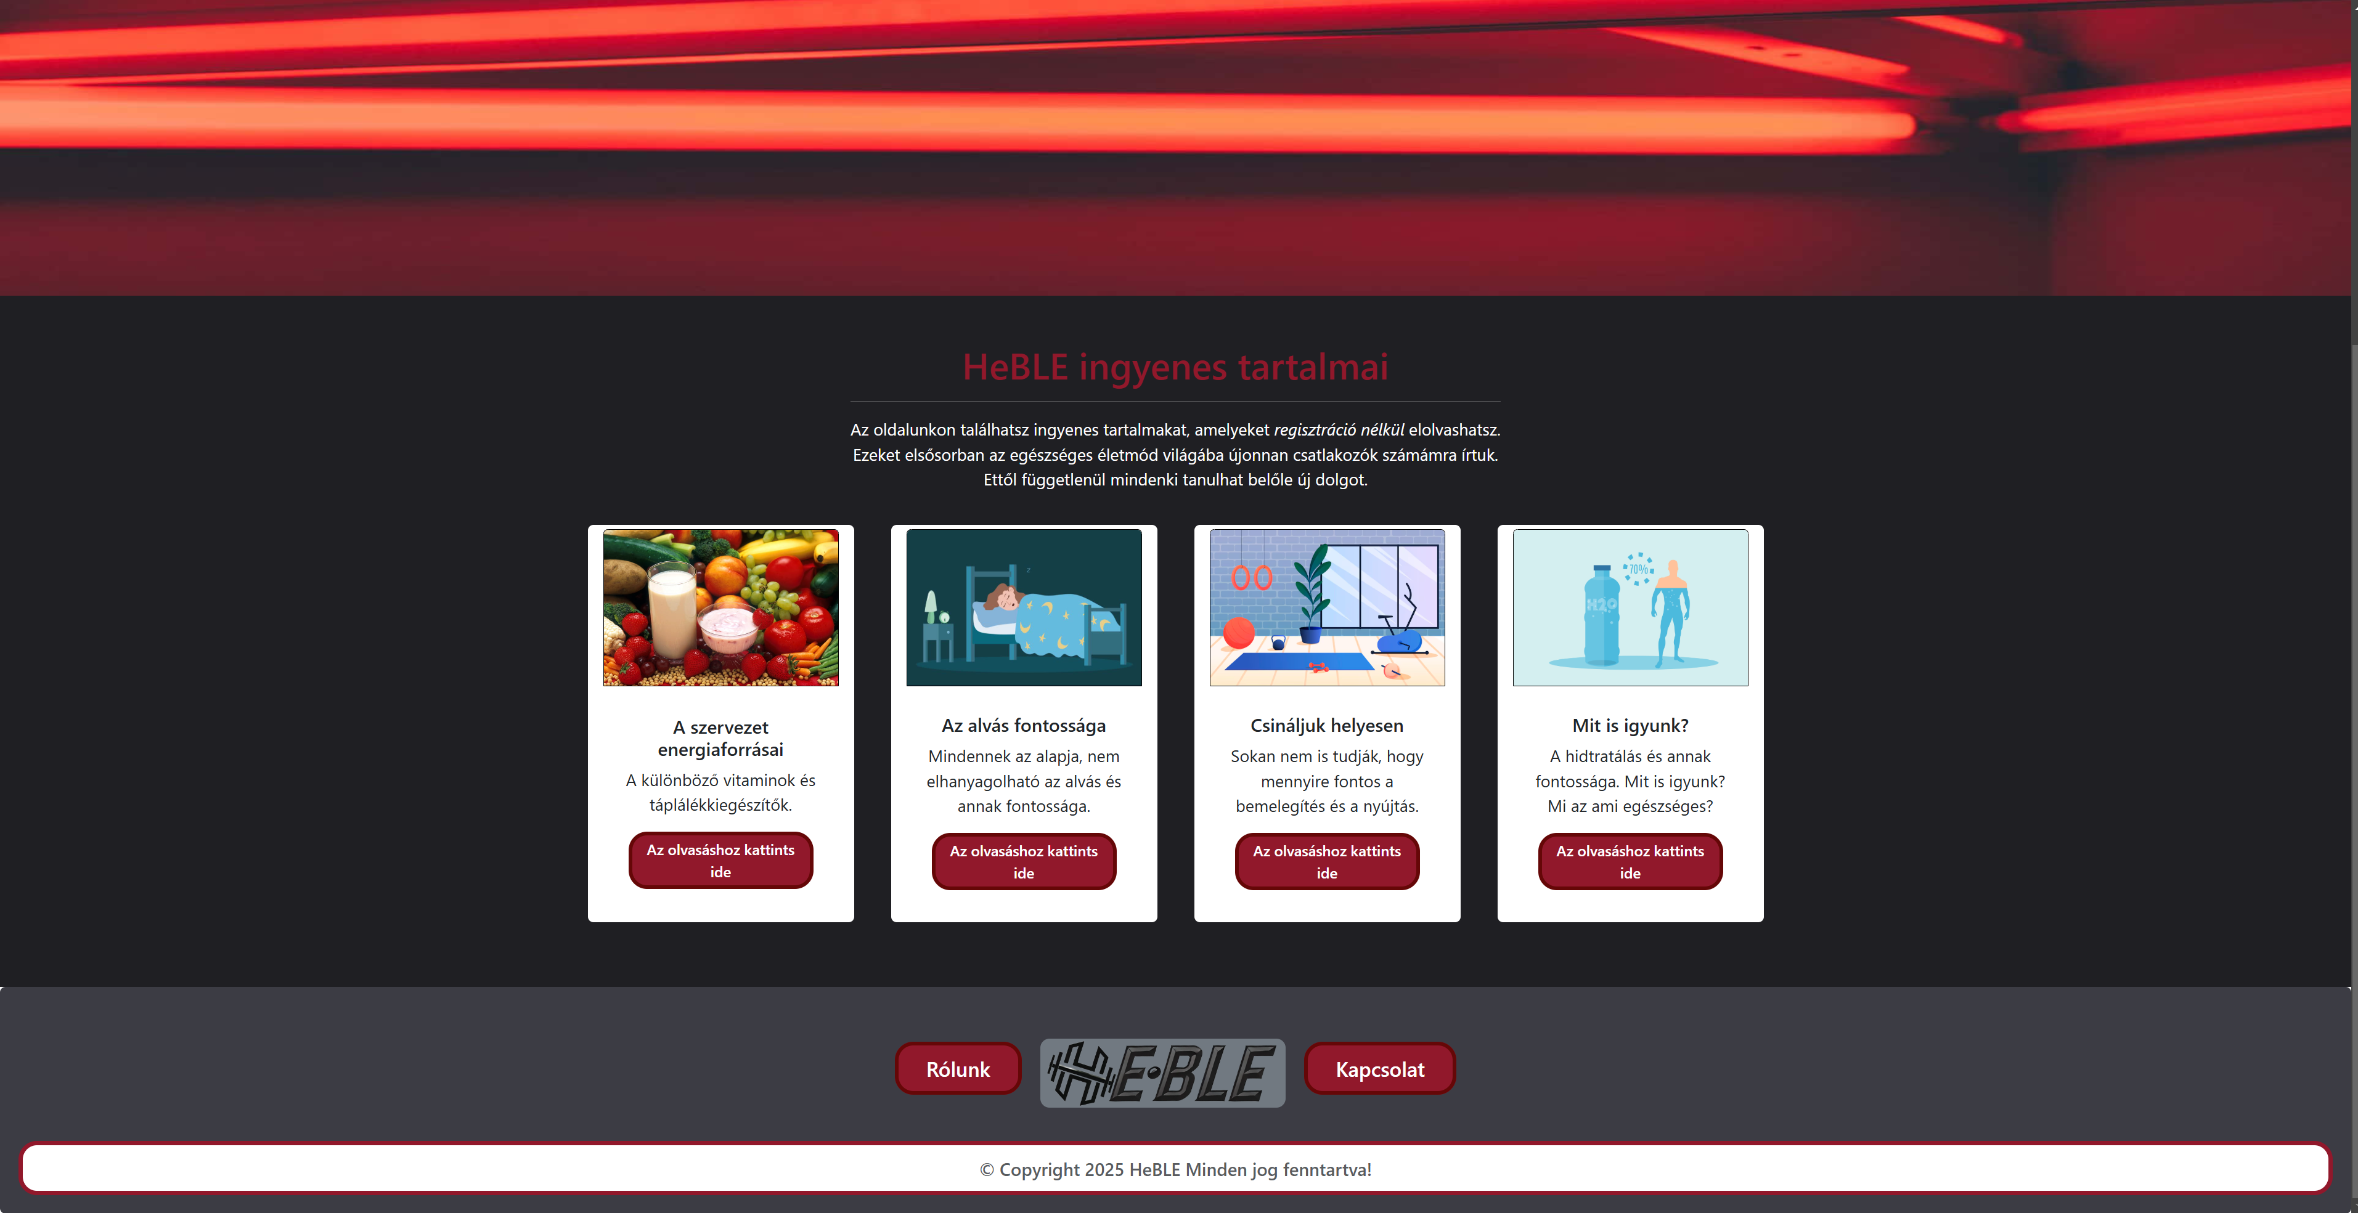
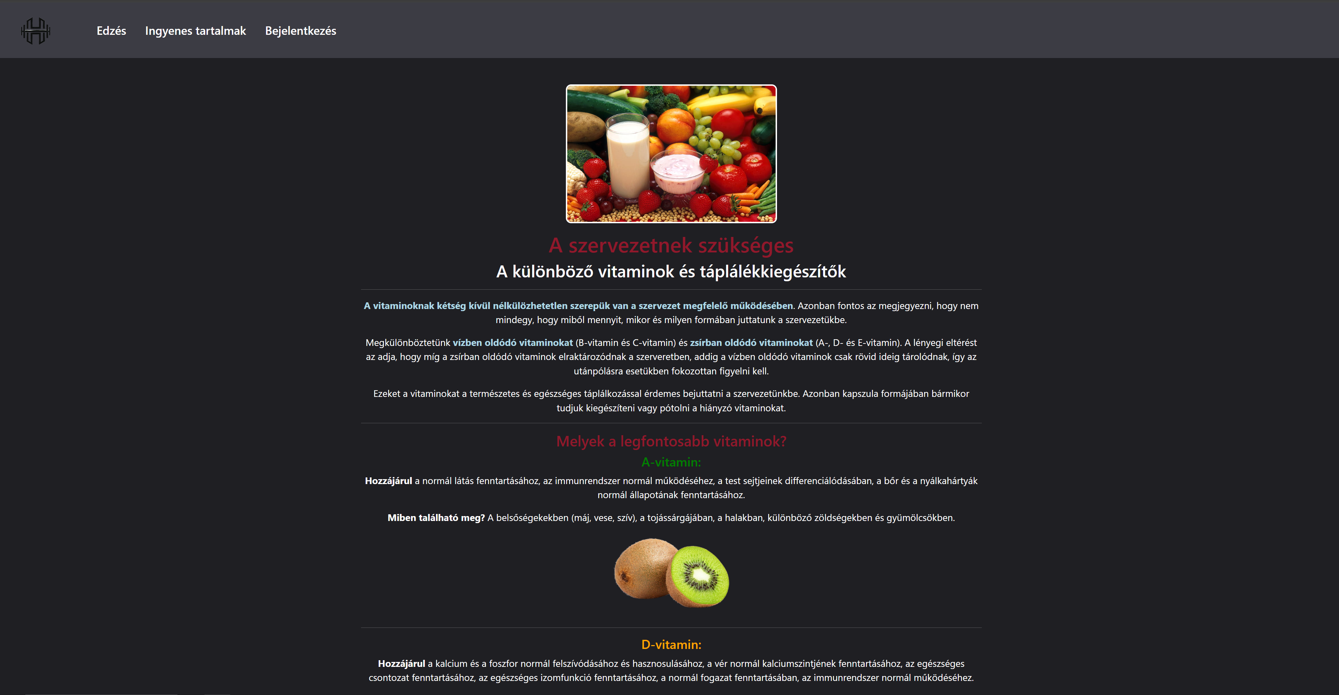
gergő’s work in details

Slide 10
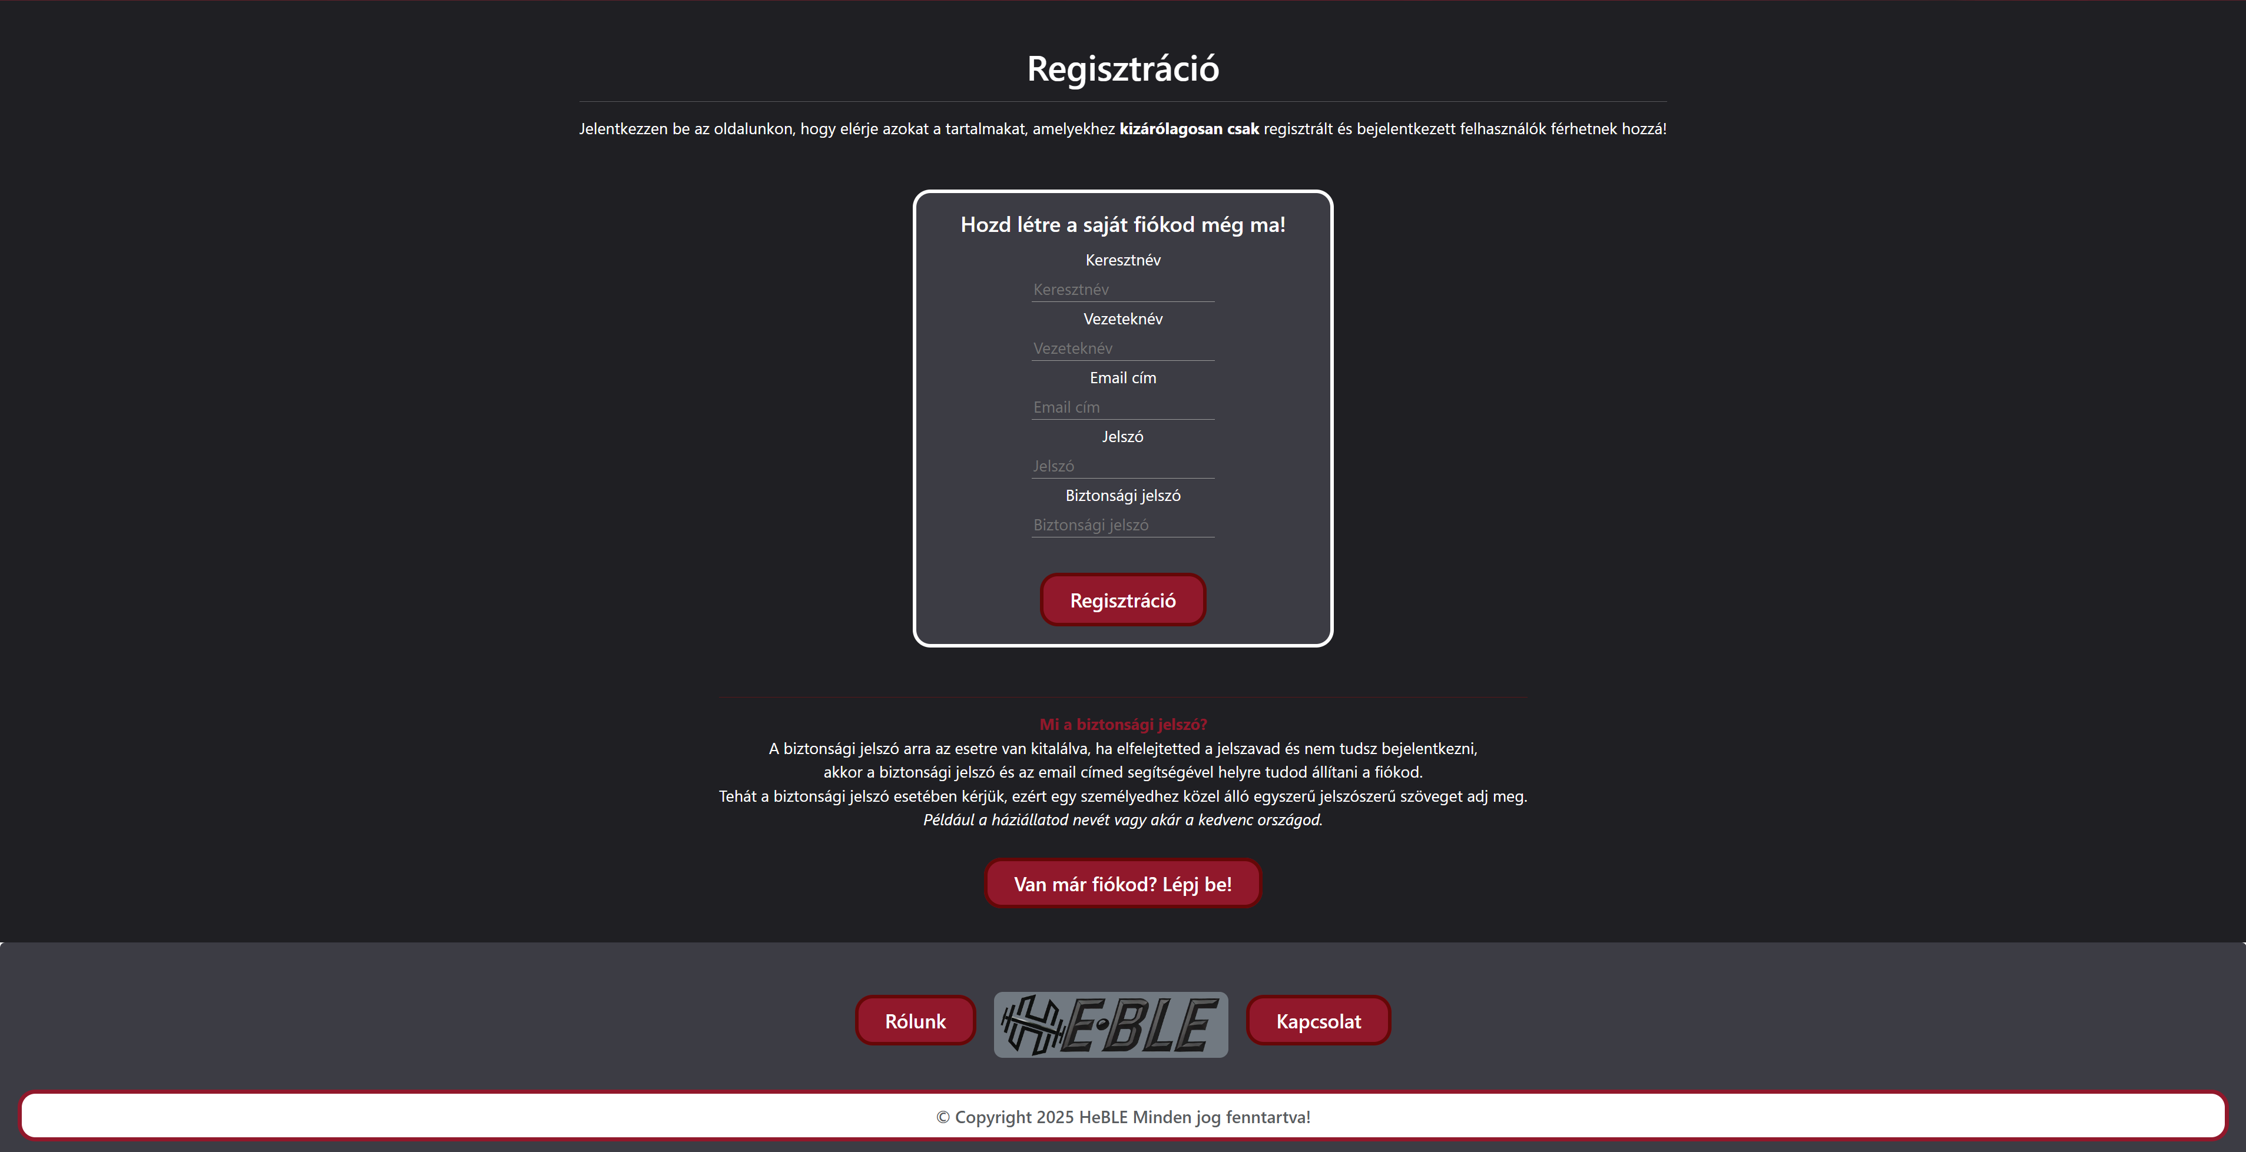
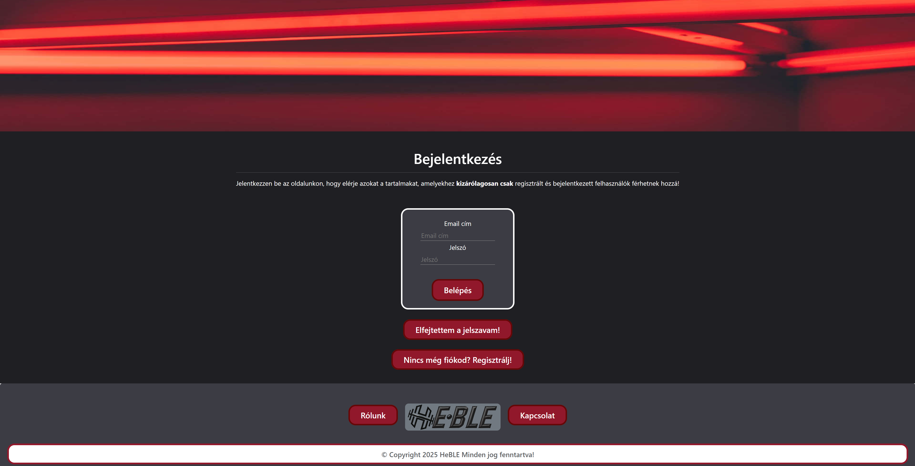
gergő’s work in details

Slide 11
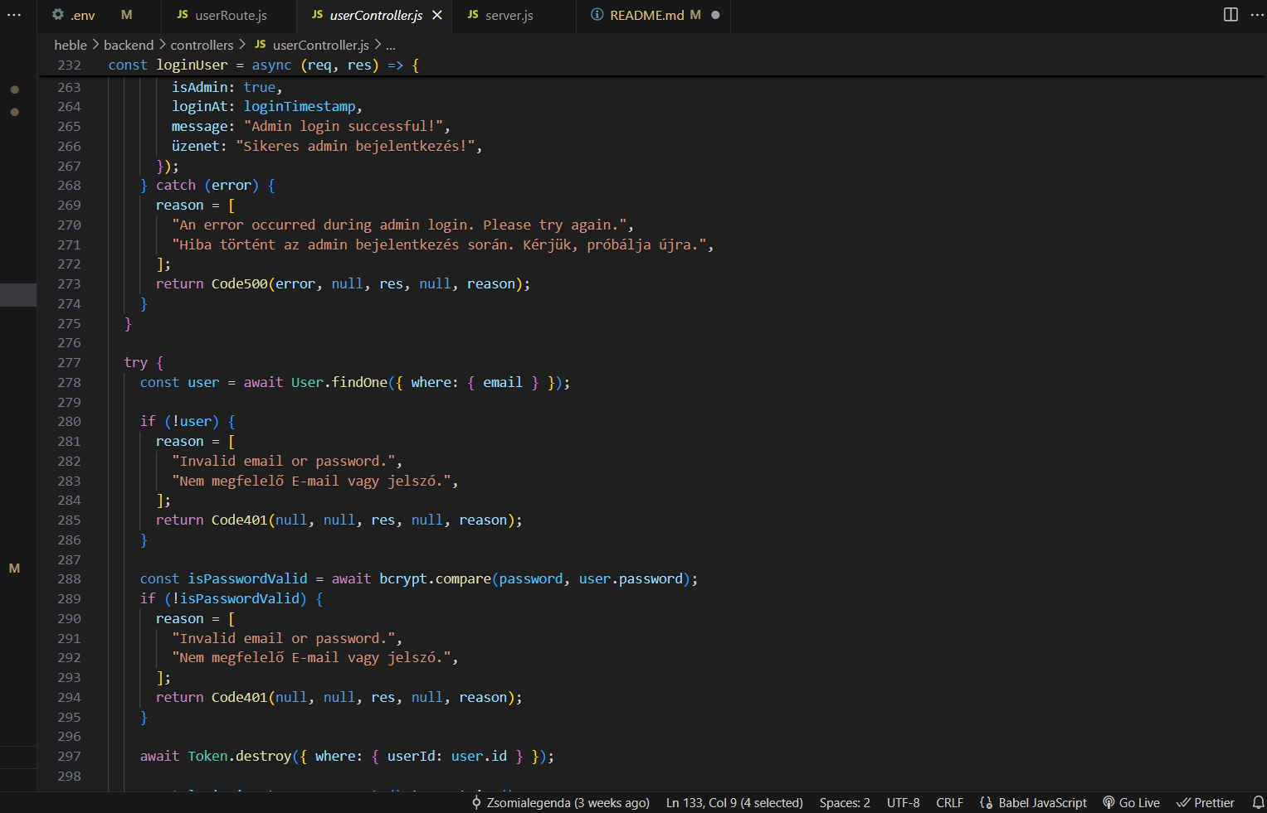
Patrik’s WORK
Backend:
The development environment was also Visual Studio Code, and the server runtime environment used for project work was Node.JS.
We used different existing packages (created and developed by others) to build our project.

Slide 12
Patrik’s work in details
The REST API under HEBLE tries to follow the normalized naming convections
This also holds true for the folder management (utils, models, controllers, routes)
The inside documentations (e.g. comments) heed the basic traditions
The HTTP codes are managed by a different controller where a main function is found called errorHandler (might not be proper to call it a controller)

Slide 13
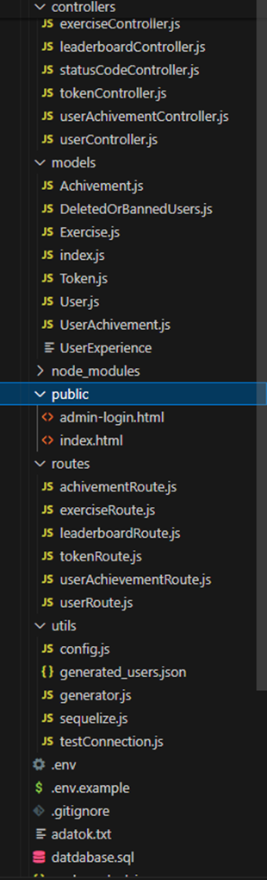
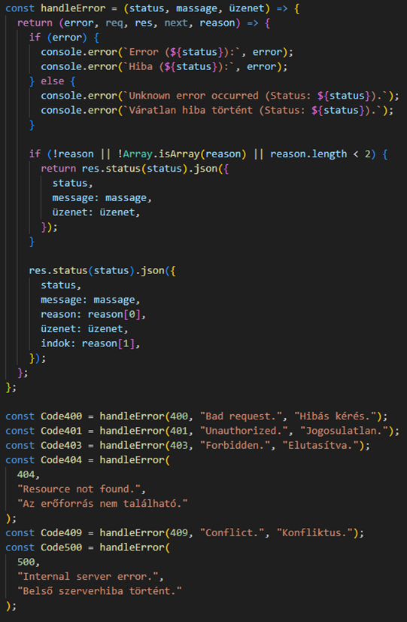
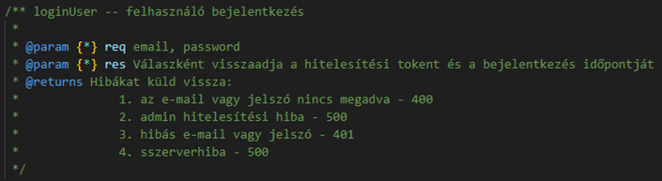
Patrik’s work in details
Screenshots from the code

Slide 14

Bence’s WORK
DESIGN
LOGO DESIGN
Software for image design and editing:
Adobe Photoshop and Canva
BANNER DESIGN

Slide 15
Bence’s work in details

Slide 16
The further developability of the software
More free readable content
Several different exercises, rewards and achievements
Opinions can be written by users through the web application, not by email

Slide 17

Thank you for your attention!
János bence dakos
Gergő fodor
patrik ANDRÁS sedlák

